Slide 1
THIS IS YOUR LESSON FOR TODAY! YOU ARE RESPONSIBLE FOR KNOWING THIS MATERIAL! YOU NEED TO GO THROUGH THIS POWERPOINT AND TAKE YOUR OWN NOTES IN YOUR NOTEBOOK!
*you don’t have to copy everything down word-for-word, but you need to write down what you think is important*

Slide 2
Sampling Methods!
How a sample is selected is a pretty big deal – it can mean the difference between making your statistics meaningful or not…
The key is selecting randomly. If it’s not random, it’s usually not worth a flip! But there are several different ways to select a random sample… check it out!

Slide 3
In a Simple random sample (SRS):
all individuals in the population have the same probability of being selected
AND
all groups of the sample size have the same probability of being selected

Slide 4
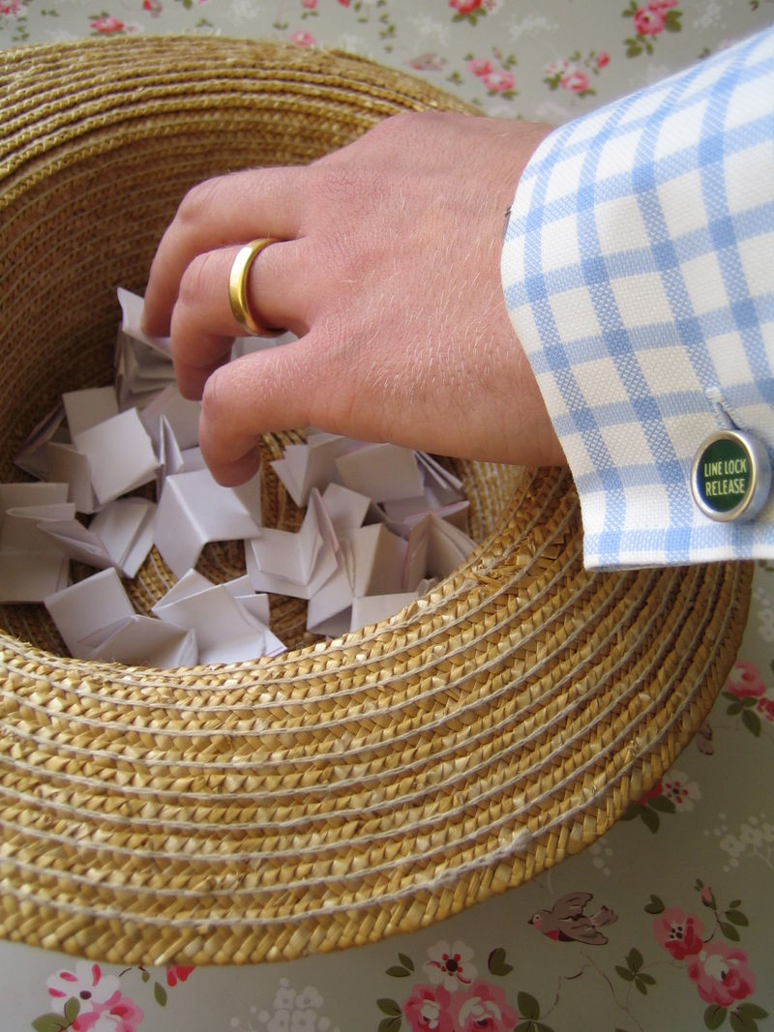
Putting 100 kids’ names in a hat and picking out 10 is a simple random sample (SRS)
Putting 50 girls’ names in one hat and 50 boys’ names in another hat and picking out 5 of each – NOT a SRS!!!!

Slide 5
Why not???
While every student has the same chance of being selected, every group does not… if you’re picking 10 students and you force there to be 5 girls and 5 boys, then there are groups that have no chance of being picked… like a group of 6 girls and 4 boys.
The only way to get a true simple random sample is to keep the whole group together.

Slide 6
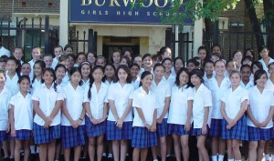
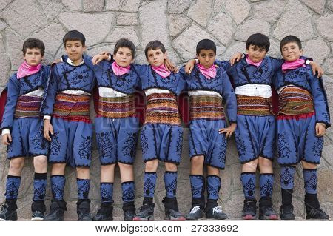
Stratified random sample:
used when the researcher wants to highlight specific subgroups within the population - the researcher divides the entire target population into different subgroups, or strata, and then randomly selects the final subjects proportionally from the different strata.

Slide 7
That example a minute ago? The one with the 50 girls and 50 boys that were separated and we picked 5 of each?
That’s a stratified sample.
Sometimes a stratified sample is actually better than a simple random sample… if you need to have opinions from all groups, like all 4 grade levels of students at FVHS.

Slide 8
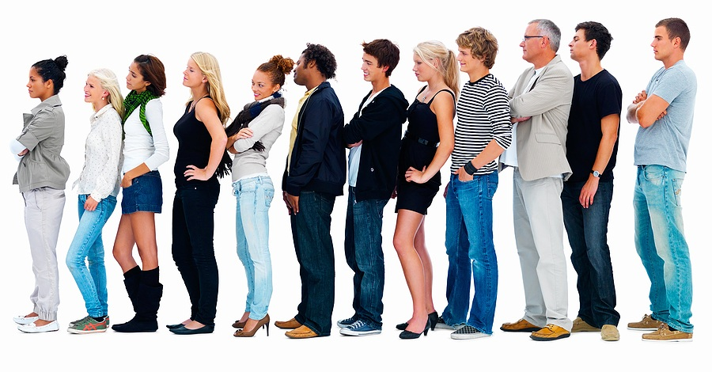
Systematic sample:
the researcher selects a number at random, n, and then selects every nth individual for the study.

Slide 9
OK, how about if I give every 4th student who walks through the door extra credit???
That’s a systematic sample… as long as I select either the number 4 or the place I start in line randomly.

Slide 10
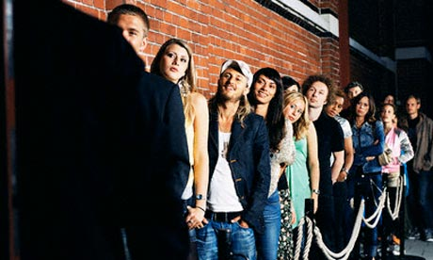
Convenience sample:
subjects are taken from a group that is conveniently accessible to a researcher, for example, picking the first 100 people to enter the movies on Friday night.

Slide 11
Convenience sample Examples
EXAMPLE: Have you ever used your family members for data for any kind of project you’ve done? That’s a convenience sample because you, the researcher, see them every day and its super convenient to get data from them!
EXAMPLE: Let’s ask the first 50 kids who show up for the basketball game how they feel about basketball.
^ Hang on…Usually, the first people somewhere share a characteristic – in this case, they may really like basketball. This creates the possibility of BIAS (we’ll talk more about that later!)

Slide 12
Cluster sample:
a sampling technique where the entire population is divided into groups, or clusters, and a random sample of these clusters are selected. All individuals in the selected clusters are included in the sample.

Slide 13
Cluster Sample Example
EXAMPLE: If we put all of the teachers’ names in a hat and pick out 5… and then go and interview every student in those 5 classes, that’s a cluster sample.
Why do this? It’s a whole lot cheaper. Let’s say NC was interested in the opinions of high school students. A simple random sample (SRS) could have someone running to hundreds of different schools. That’s inconvenient, time consuming, and expensive! By cluster sampling, they could select a rural, urban and suburban school and be done with it.

Slide 14
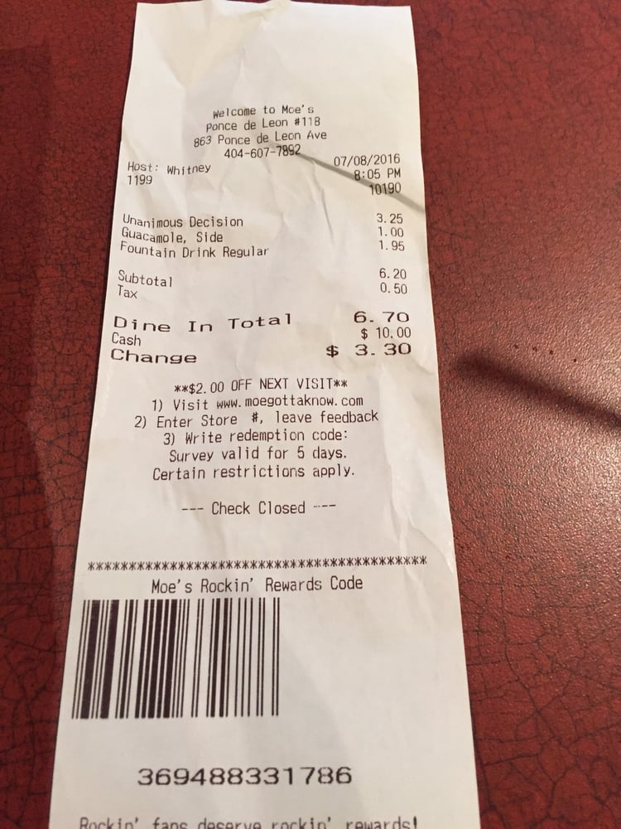
Voluntary Response sample:
a sampling technique where the interviewer counts on people to phone in or mail in responses.

Slide 15
Voluntary response Example
Usually, the people who call have pretty strong opinions one way or another.
Think about it… who calls in to radio stations to voice their opinions on political elections? People who have VERY strong opinions! People who aren’t as passionate won’t bother to call in!

Slide 16
OK, now try these!!!

Slide 17
Name that sample!
The names of 70 contestants are written on 70 cards, the cards are placed in a bag, the bag is shaken, and three names are picked
from the bag.
Simple random sample
Stratified sample
Convenience sample
cluster sample
Systematic sample

Slide 18
Name that sample!
To avoid working late, the quality control manager inspects the last 10 items produced that day.
Simple random sample
Stratified sample
Convenience sample
cluster sample
Systematic sample

Slide 19
Name that sample!
A researcher for a bus service interviews all of the passengers on six randomly selected buses.
Simple random sample
Voluntary response sample
Convenience sample
cluster sample
Systematic sample

Slide 20
Name that sample!
A radio DJ asks people to call in and give their opinion of the station’s new playlist.
Simple random sample
Cluster sample
Convenience sample
Voluntary response sample
Systematic sample

Slide 21
Name that sample!
A researcher randomly selects and interviews fifty male and fifty female teachers.
Simple random sample
Stratified sample
Convenience sample
cluster sample
Systematic sample

Slide 22
Name that sample!
Every tenth student entering the basketball game is searched thoroughly.
Simple random sample
Stratified sample
Convenience sample
cluster sample
Systematic sample

Slide 23
Types of Bias in Survey Questions
Bias – when a sample systematically favors one outcome
*BIAS CAN BE INTENTIONAL OR ACCIDENTAL!
Sometimes the researcher may intentionally receive his/her sample in a way to get the results/data that they want!
Sometimes they may take a sample and accidentally end up with biased results if that sample isn’t truly representative of the population!

Slide 24
Wording Bias – occurs when the wording of a question affects the way that someone answers it
EXAMPLE: If you found a stranger’s wallet on the ground with $100 cash in it that that person worked really hard for, would you be a good citizen and return the wallet or would you be selfish and keep the money?
…Clearly, the researcher’s wording of the question will affect the way someone answers this question!
EXAMPLE: Have you traveled a lot recently?
This one isn’t as obviously biased as the one before… but this question still counts as biased because it is TOO VAGUE! What counts as traveling? What counts as “a lot?” How recently are we talking here? The data will be biased when there isn’t a clear scale

Slide 25
Undercoverage bias – occurs when the sample is not representative of the population
EXAMPLE: Let’s say Mr. Enns wants to know if underclassmen should be allowed to go off campus for lunch. If he asks a sample of 50 seniors, they will probably respond that underclassmen should NOT be allowed to go off campus! This would be undercoverage because the other students at school (aka the underclassmen) are not being represented in this study!

Slide 26
Response bias – occurs when survey respondents lie or misrepresent themselves
EXAMPLE: Let’s say I ask everyone in class to raise their hand if they’ve ever cheated on a test before. I’ve actually done this example in class before, here’s how it went….
Students looked around the room and a few people slowly raised their hands and everyone kind of laughed! I then asked those students to keep their hands raised if they had ever cheated on a test in MY class and EVERY TIME I ask this part EVERY SINGLE HAND goes down! Why???? I’d LIKE to think its because my students don’t cheat on my tests…. But what is probably happening is that my students don’t want to admit to ME that they’ve cheated on my tests! So I am receiving biased data because my students are choosing to lie/misrepresent themselves!

Slide 27
Nonresponse bias – occurs an individual is chosen to participate, but refuses
EXAMPLE: Have you ever sat down for a family meal only for the phone to ring?? Your parent gets up to answer the phone, only to immediately hang up and say it’s for some random political survey?? Your parents are engaging in NONRESPONSE bias because they are refusing to participate

Slide 28
Voluntary response bias – occurs when people are asked to call or mail in their opinion
EXAMPLE: Ever heard of the app “YELP?” Its where people can leave reviews on restaurants they go to. You’ve been to hundreds of restaurants in your life… how many Yelp reviews have you left? Want to know how many I’ve left? TWO. Of all the restaurants I’ve dined in, I’ve only left two yelp reviews. One of them was to give an excellent review to a restaurant that was extremely accommodating to my large group. Our server was kind and helpful and even gave us some free dessert. The ambiance was amazing. I was so passionately happy about my experience that I knew I had to leave a 5 star review.
…..Wanna know about the other yelp review I left? It was for a restaurant that SUCKED. Like, the worst dining experience of my life. We had to wait on our table for over an hour (even though we had a reservation), our waiter was dismissive and rude, there were bugs all over the restaurant, our order was wrong and took so long to fix that I finally just cancelled my order. I was so mad that I wrote the review on the ride home and YALL I did not hold back sharing my feelings.
^Both of these examples show VOLUNTARY RESPONSE BIAS! The kinds of people who CHOOSE to respond to a survey are ones who have STRONG OPINIONS one way or the other!

Slide 29
NOW WORK ON YOUR HOMEWORK !!!!!

